Slide 1
Workers Compensation
Accident Prevention
Claims Management

Slide 3
Notes:
Introductory slide into the “iceberg effect”. Describes the hidden cost of accidents – how they affect the bottom line.

Slide 4
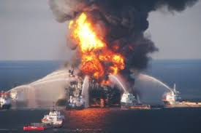

Slide 5
H.W. Heinrich:
~98% of all accidents are Preventable:
~88% are from Unsafe Behaviors
~10% are from Unsafe Conditions
Other ~2%….?

Slide 6
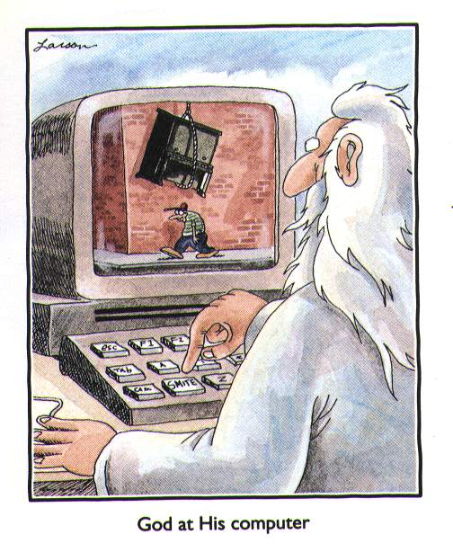

Slide 7
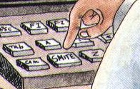

Slide 8
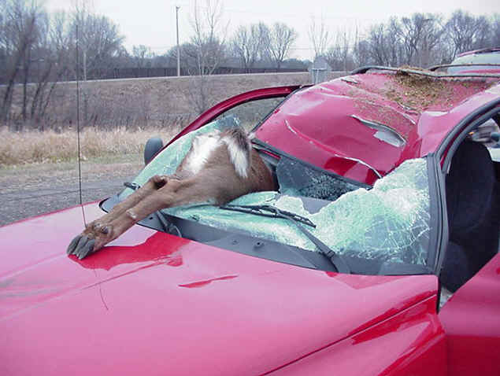

Slide 9
Accidents Can Be Prevented
Preventable Causes:
Unsafe behaviors
Unsafe conditions
Focus on Preventable
Be Prepared for Other

Slide 11
Hazard Control Hierachy
Engineering Controls
Administrative Controls
Personal Protective Equipment

Slide 12
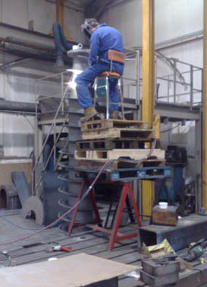

Slide 13
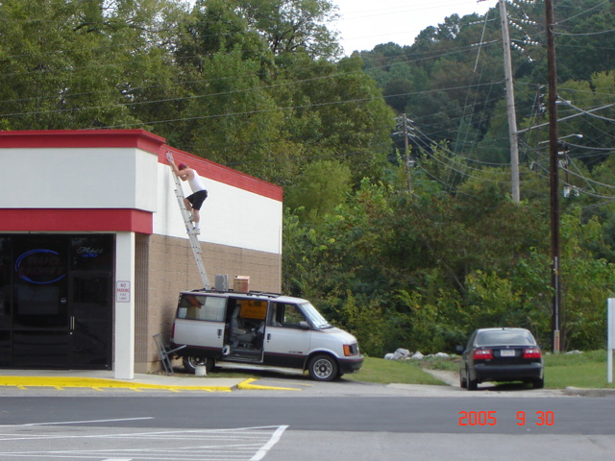

Slide 14
Implement a Written Safety Program/Policy
Upper management commitment should be on 1st page of policy
Policy should focus on preventing major injury sources (frequency/severity)
Include any OSHA required programs

Slide 15
Hold Employees Accountable
Assignment of safety responsibilities
Progressive discipline policy
Enforcement of safety rules
1st line supervision
Documentation

Slide 16
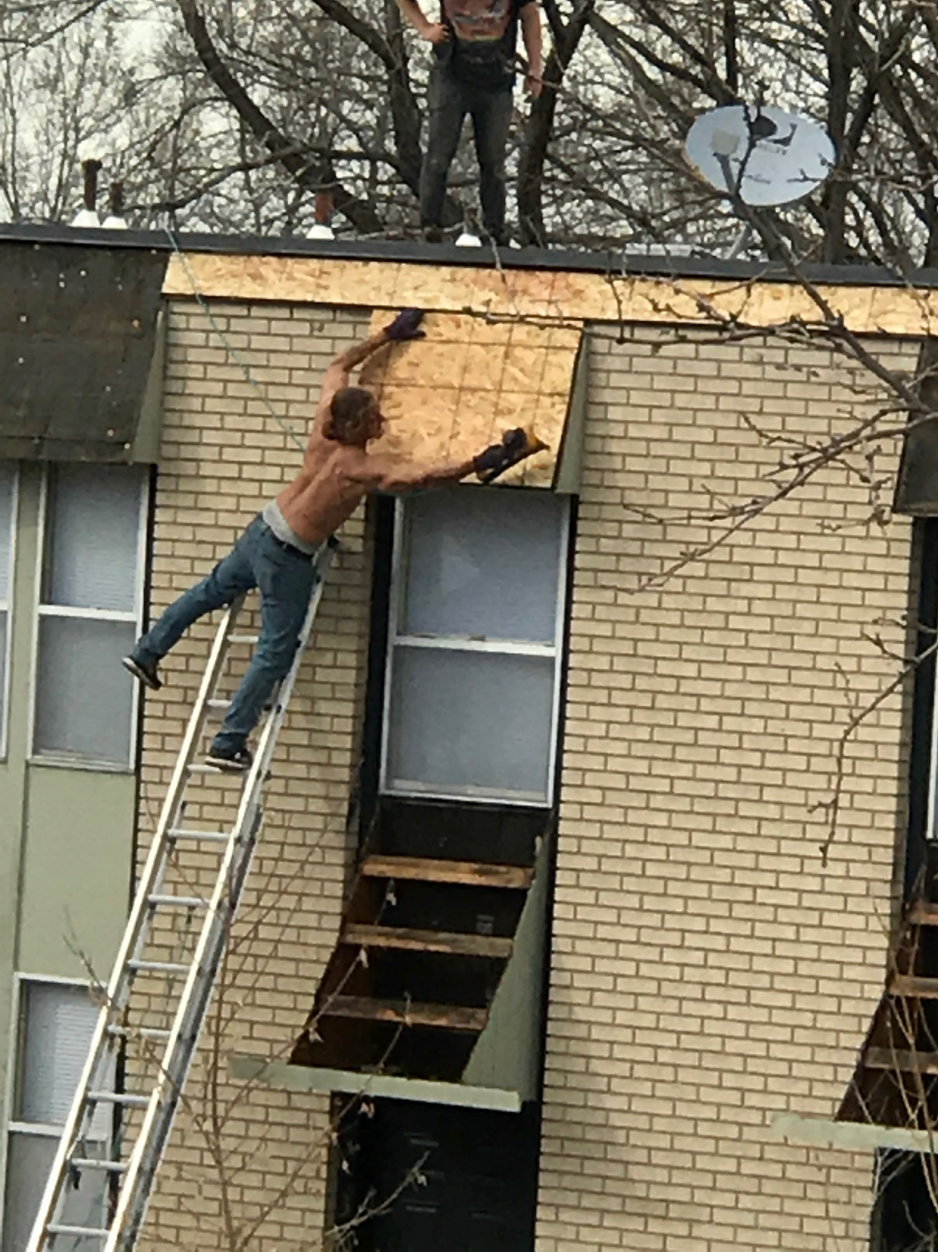

Slide 17
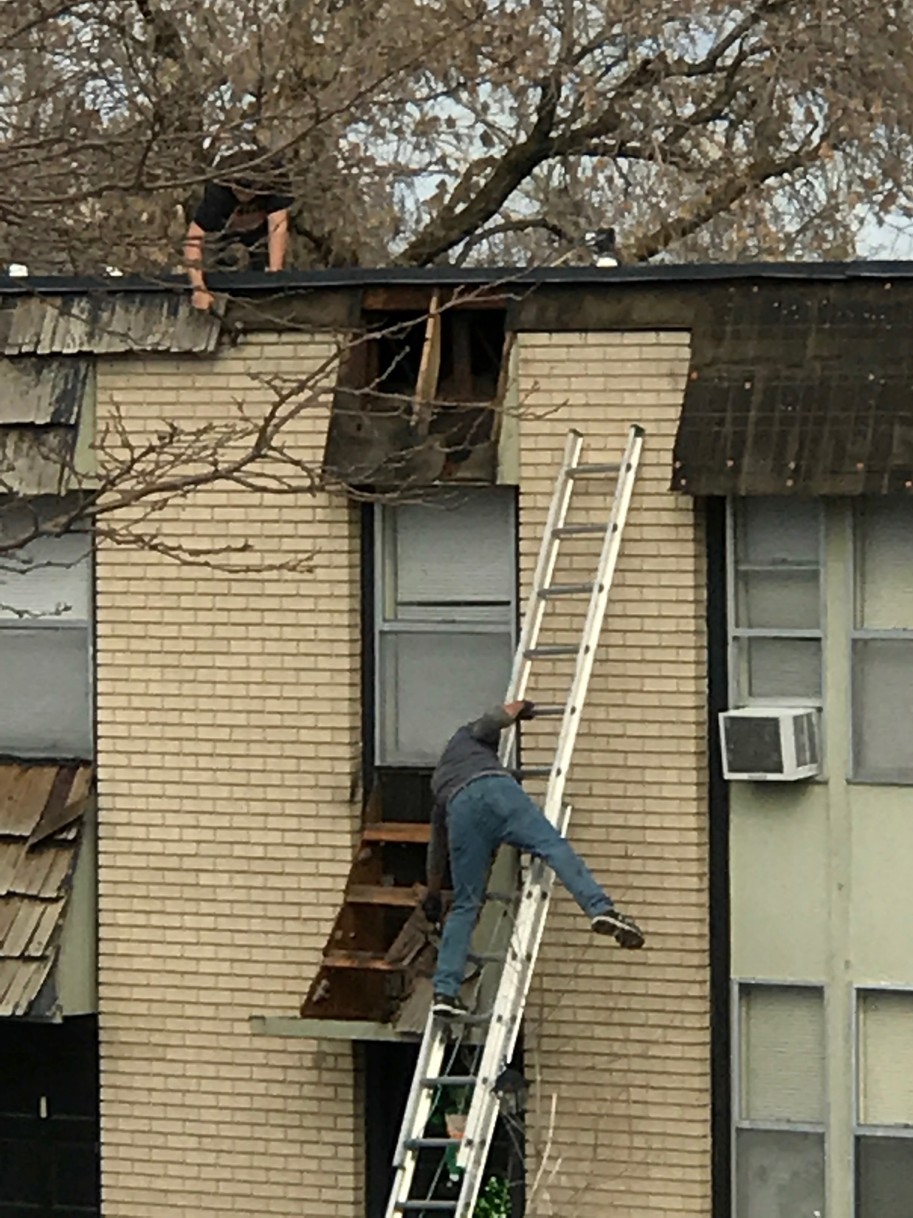

Slide 18
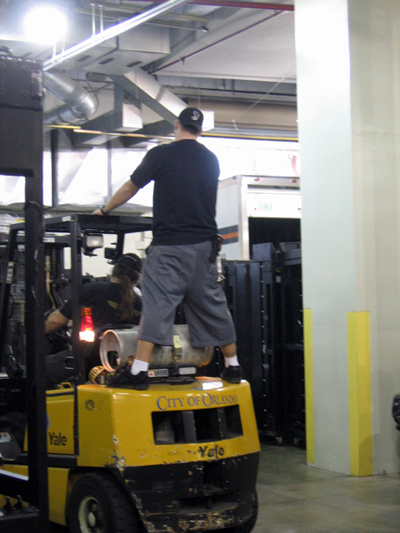

Slide 19
Hazard Identification & Control
Work area walkthroughs/surveys
Unsafe conditions, unsafe acts
Housekeeping, floors and work surfaces
Work practices, lifting, use of personal protective equipment
Machinery and equipment hazards

Slide 20
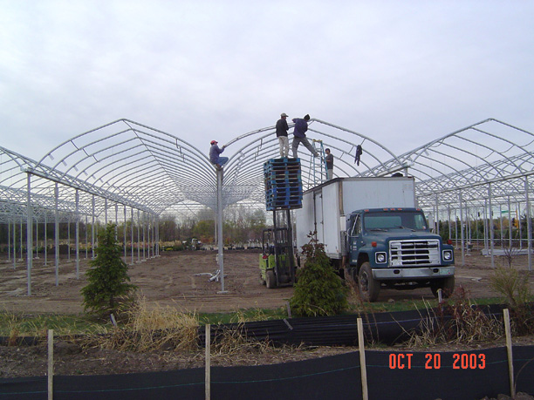

Slide 21
Training
New Hire Orientation
Ongoing Safety Meetings
What to train on
When
Supervisor Training
Documentation

Slide 23
Workers Compensation
Workers compensation insurance is a no fault system covering injuries & occupational diseases to employees which occur by accident arising out of and in the course of employment
Exclusive Remedy for Workplace Injuries

Slide 24
Procedure for Reporting Injuries
Report all accidents, injuries, near misses immediately
Whom to report to
How to report it
What information is needed
All incidents should be investigated and documented

Slide 25
When do we File a Claim?
Injured employee visits a medical facility
What about first aid injuries?
When do we use the emergency room?
Claims can be filed
Electronically www.wcf.com
Fax 385 351 8275
Mail

Slide 26
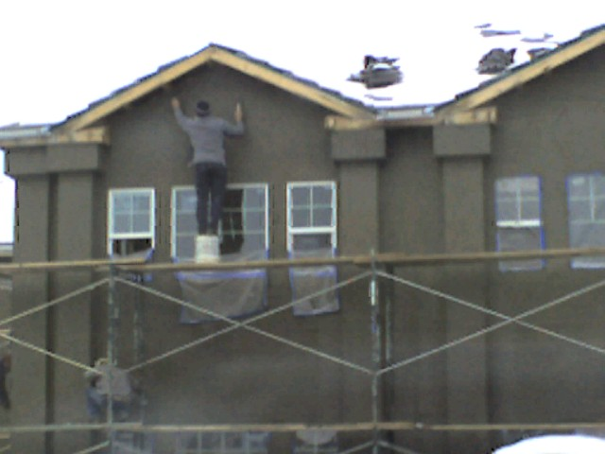

Slide 27
Work With WCF Adjusters
Claims adjuster can:
Analyze trends/offer suggestions
Help set up transitional/modified duty
Check into the “red flags” & help prevent fraud

Slide 28
Medical Management of Injury
Use the preferred provider if possible
Accompany injured employee to the clinic
Require post accident drug testing
Inform the physician of job requirements and accommodations that are available

Slide 29
Investigate & Document Every Accident
Look at Accident Site
Determine Why it Happened
Secure Evidence/Take Photographs
Interview Witnesses
Fact finding not fault finding

Slide 31
Return to Work
Provide transitional/modified duty ASAP
Helps manage medical costs (remember one large lost time injury could affect your bottom line for three years through your e-mod)
Increases employee morale
Increases communication
Helps handle the difficult situations

Slide 32
Claimant Fraud
Double Dipping
No Industrial Injury
Malingering

